Slide 1
Team 3 presents Team 5 presents Spur
Simran, Hannah, Bhavya, Nils

Slide 2
Table of contents
01
02
05
03
04
Project Overview
Market Research
Concept Video
Values
Tasks

Slide 3
01
Project Overview

Slide 4
Spur
Embrace Free Time (no activation energy required)

Slide 5
What is Spur?
For the person who wants to do something but doesn’t want to put in the effort to do it
Tackles the difficulty of finding and planning things to do
Connects users to each other through activities
Offers an alternative to “wasting time”

Slide 6
Proposed Solution
Swipe left or right on suggested activities
Get all the information you need on the details of activities (Location, how often it occurs, any fees, websites/important links)
Also see which of your friends are also interested in these activities

Slide 7
Market Research
02

Slide 8
Eventbrite
Eventbrite is a global online marketplace for live experiences that enables its users to search for, find, and create events.
What Works
What Doesn’t
Provides categories of events and activities that you can sort by
Sorted by closeness (date and location)
Can follow/keep up with organizations that host events you like
Requires user to know what type of event they want
Not socially connected to other users/prior friends
Ticket-based or pre-scheduled event based

Slide 9
Eventbrite Takeaways
Eventbrite requires more activation energy from the user,
Take inspiration from connection to local communities through area-specific events
Focus more on strengthening connections with people the user already knows
Making the searching process more fun and effortless

Slide 10
Merrier
A past CS147 Project addressing mental health struggles with a platform to connect with others to chat or do activities
What Works
What Doesn’t
Shows events by proximity
Can see what other users are going to events
Other users can invite you to events
Events must be posted by users
Events must be manually searched and found by users
Variety of activities depends on nearby user base
All in-person/social based activities

Slide 11
Merrier Takeaways
Merrier provides a base for social connection to other users
Can incorporate social principles through user invitations and info
We want to focus more on the activity and providing experiences, while the social aspect is more of a secondary task
Providing a variety of activities, including social and individual

Slide 12
Meetup
The people platform—Where interests become friendships
What Works
What Doesn’t
Wide variety of events: tarot card readings, networking
meeting based on shared interests
Google suggested: "Why does no one use meetup?"
Answers: The quality of events is low.
Because it's free, people say they are going but don't go.
Some people are just awkward/uncomfortable. In their words: "I feel like I don't fit in… I feel like I am going to die alone"

Slide 13
Meetup Takeaways
We can take inspiration from the wide variety and scope of activities meetup offers
Meetup shows that the quality of the people will be ascribed to the quality of the app.
Importance of actually getting people to these events
We want to focus on smaller activities, more in the moment, less planning
Plan to include spontaneous,individual activities too

Slide 14
Refresh
A past CS147 Project that aimed to replace mindlessly scrolling with productive tasks
What Works
What Doesn’t
Fun UI where it shows potential productive tasks as shapes on the screen
App actively interrupts mindless scrolling time via reminders
The phrasing of "do something" was vague and unintuitive
Suggested tasks are all productivity based

Slide 15
Refresh Takeaways
Learn that actively interrupting mindless scrolling is only appreciated by users sometimes
Take inspiration from success in redirecting users
“Productive alternatives to mindless scrolling have to be immediately gratifying"
We want to focus more on fun/non-productive activities other than scrolling on your phone, avoid the western obsession with productivity

Slide 16
CitySocializer
Former subscription-based social networking website based in London
What Works
What Doesn’t
Uses common interests and local events to help people make new friends offline
Target members are described as recent graduates, recently relocated individuals, empty nesters or newly single
The pandemic forced them to pivot from their "online do offline" model to a virtual events discovery platform and eventually shut down
Main motivation is social connection

Slide 17
Refresh Takeaways
Take inspiration to think of how newly relocated people who do not have local connections can still derive value
We want to focus on spending time more satisfactorily by leveraging pre-existing relationships rather than building new relationships from scratch

Slide 18
What Sets Us Apart
Focus on the activities and interesting events, less on forming new social connections
  Motivation to meet new people > motivation to do things with people you know
Spontaneity of activities and variety of activity types (virtual, social, individual)
Gamifying the searching process to reduce intrinsic motivation required to find activities

Slide 19
03
Values

Slide 20
Stakeholders
Users(people with free time/wanting to use their free time better)
Event holders (community members/users)
People who attend local events/participate in activities already

Slide 21
Tarot Cards of Tech
The Smash Hit
The BFFs
Might cause tensions within local existing communities with an influx of newcomers (eternal september)
Disruption of group/organization cultures and norms
Users might turn to app instead of experience and knowledge of friends
Friends with different interests could drift apart
Users may feel pressured to attend events they see many of their friends are at
Increase FOMO

Slide 22
Addressing Ethical Implications
Focus on showing activities “in the moment”
  Incorporate social factors in an optional manner
Connect users with ways to sign up for activities/events to prevent overcrowding
  Event holders can limit capacity
Provide multiple options/groups per activity
  Avoid overwhelming one community, provide a variety of places where users can engage in the activity
Allow users to toggle between showing their interest or not

Slide 23
04
Tasks

Slide 24
Our Tasks
Moderate
Get more information on said events/activities
Simple
Complex
Find interesting events or activities you can do at that moment
Attend/participate in these events or activities

Slide 25
Bonus Tasks
Moderate
Complex
Find which friends are also interested in these activities/events
Connect with local communities through location or group-specific events

Slide 26
05
Concept Video

Slide 27
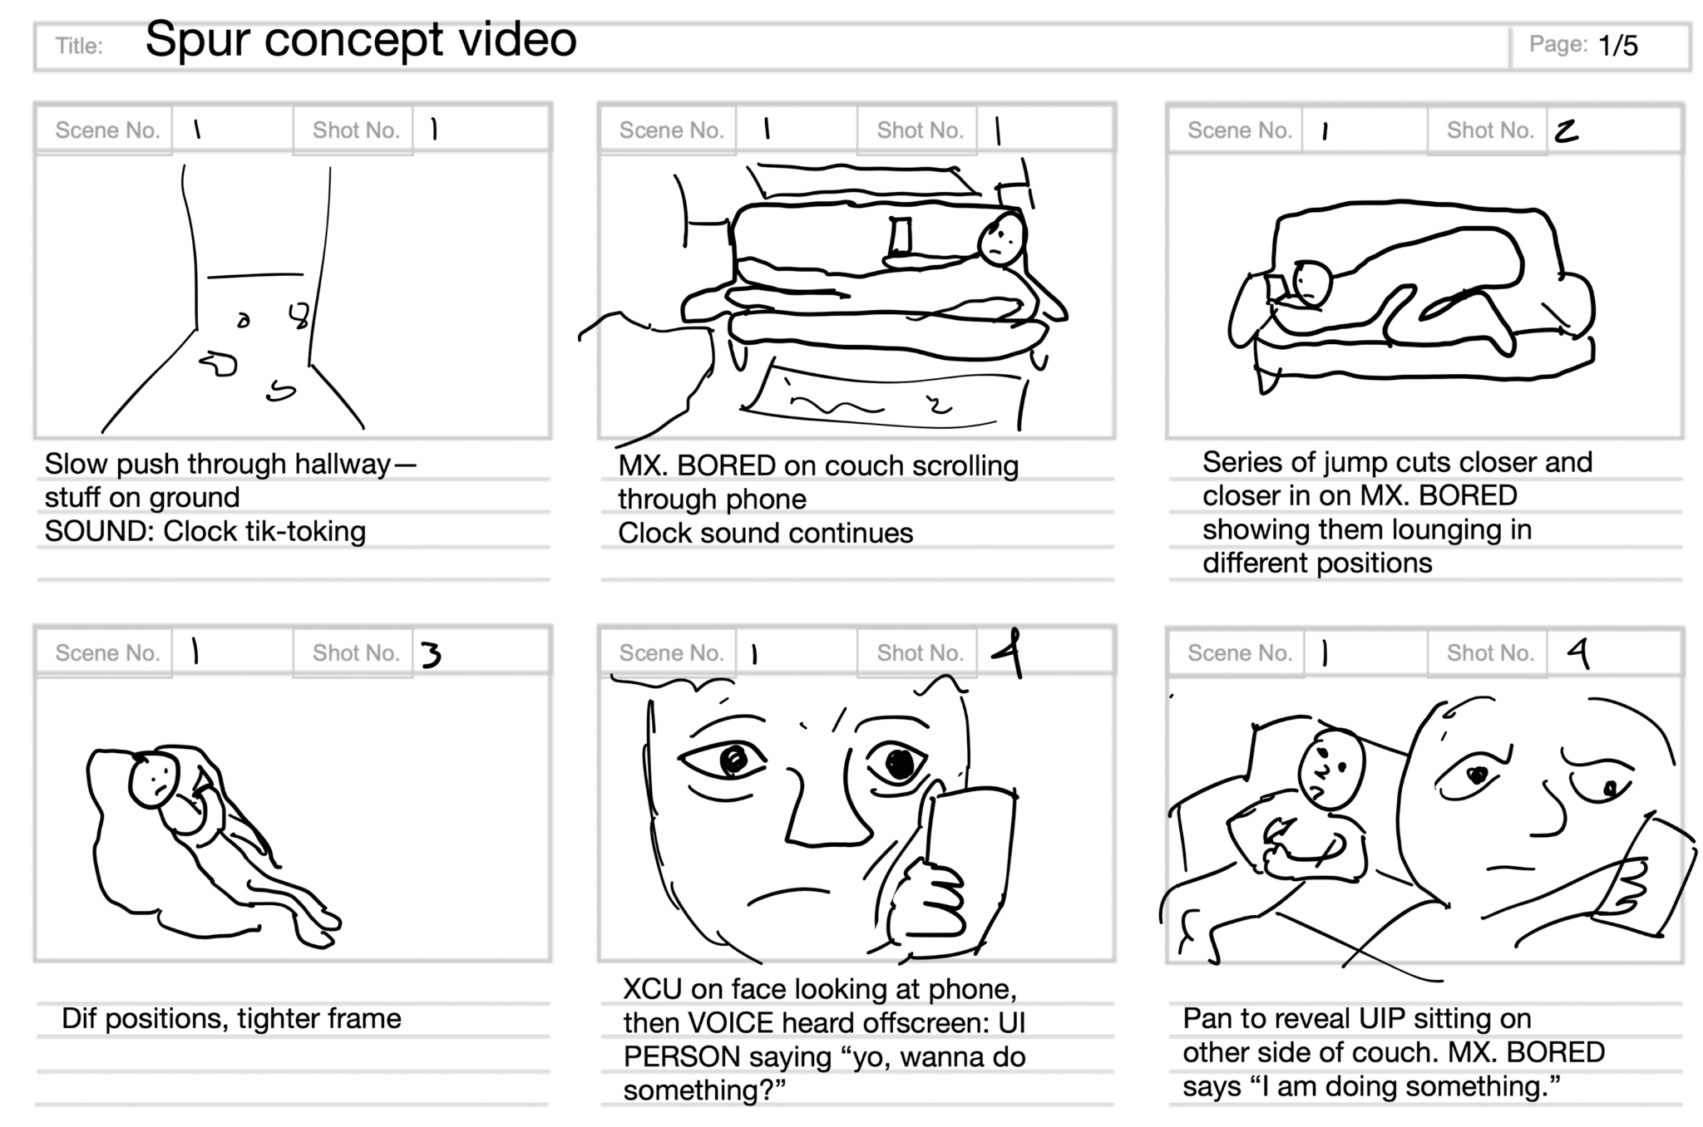
Storyboard

Slide 28
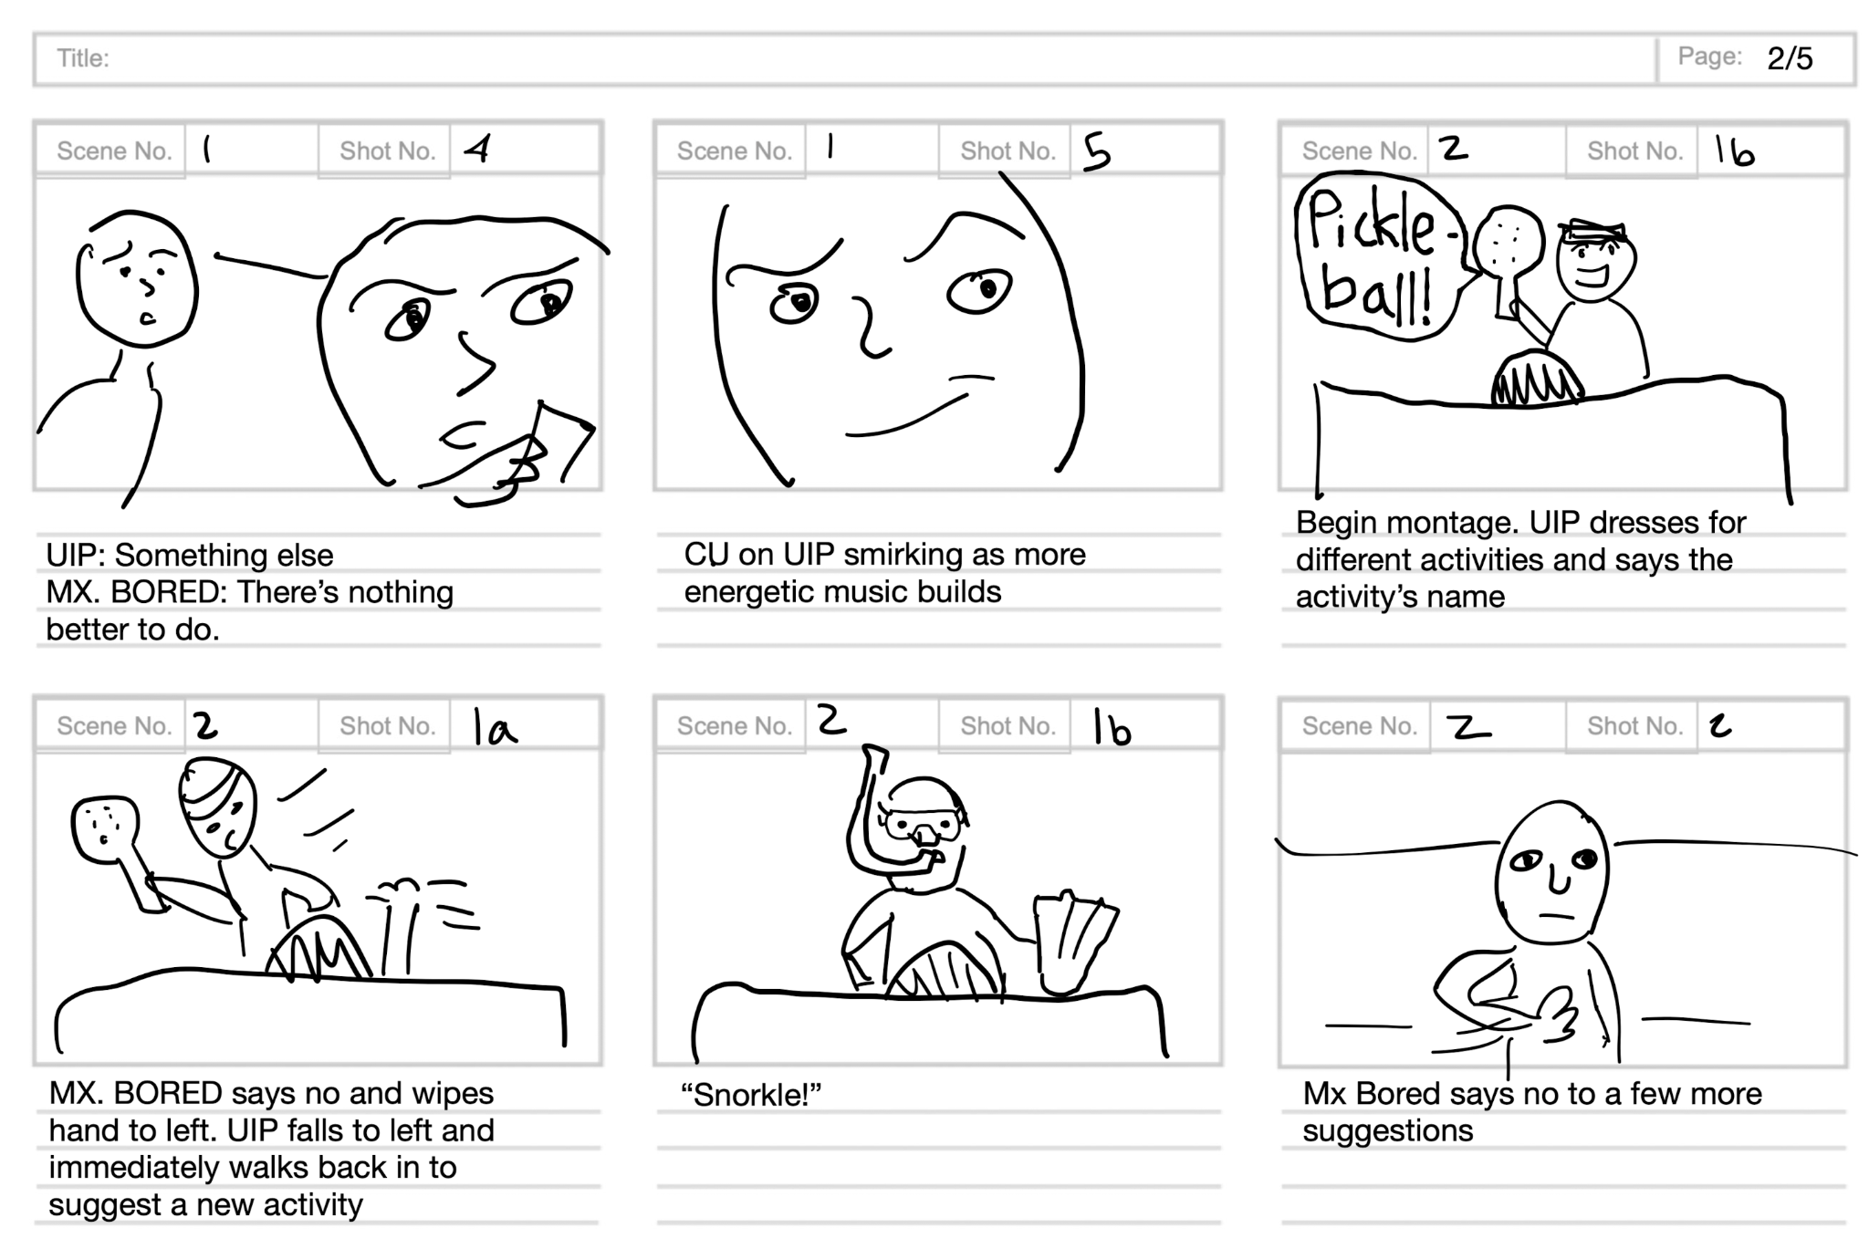
Storyboard

Slide 29
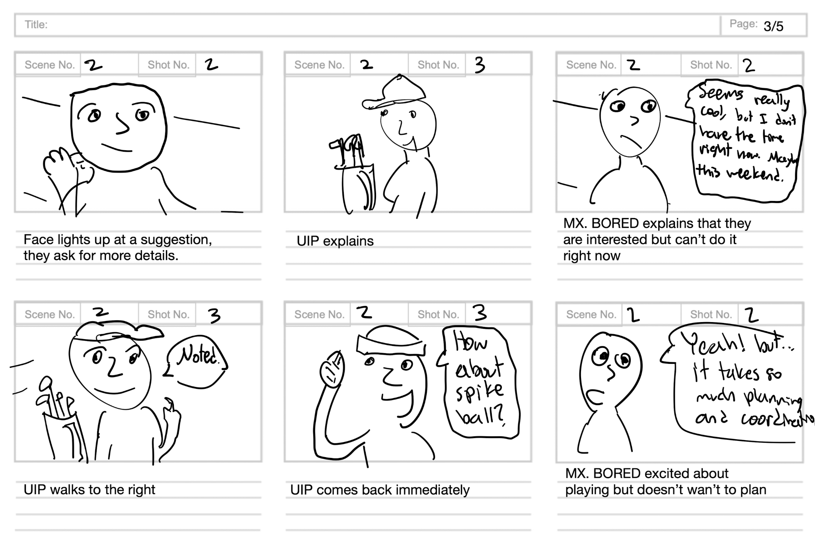
Storyboard

Slide 30
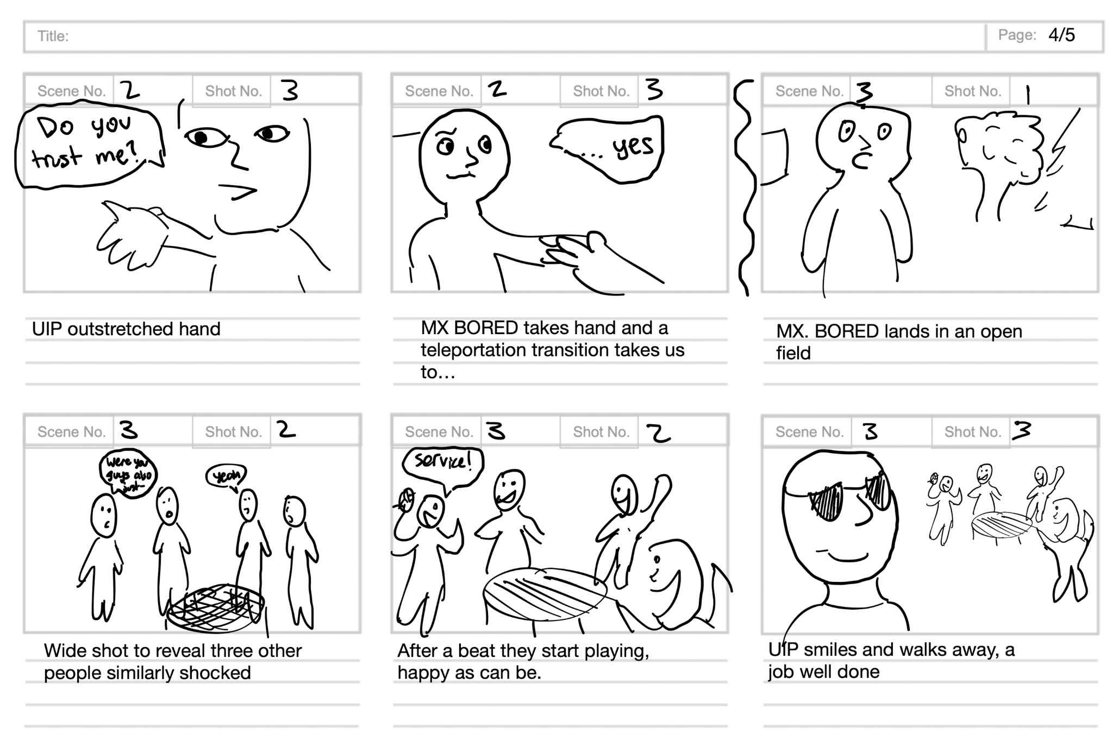
Storyboard

Slide 31
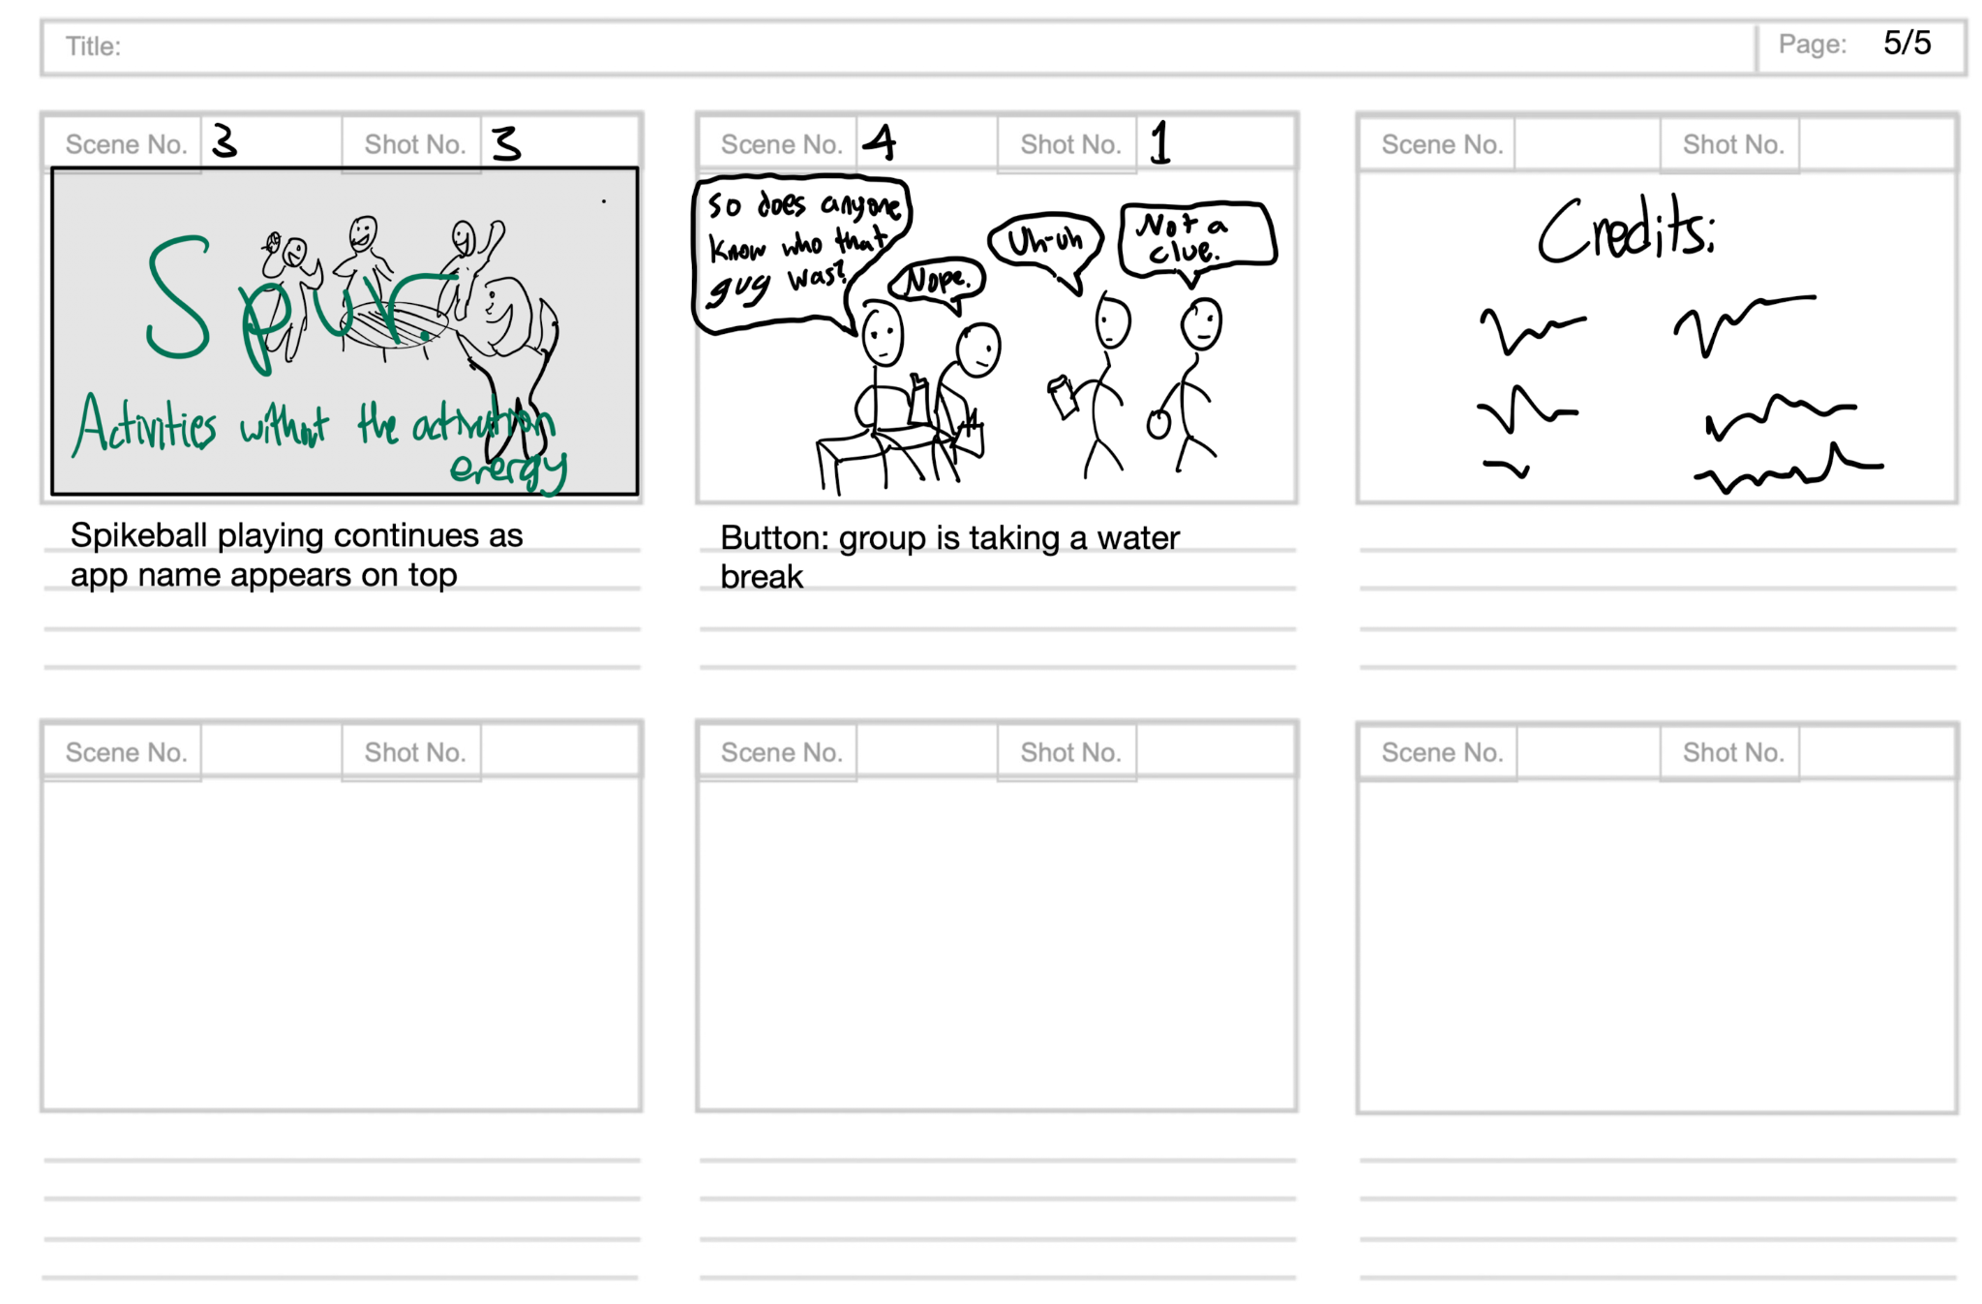
Storyboard

Slide 32

CONCEPT VIDEO
https://www.youtube.com/watch?v=HesLB2RxBgI&ab_channel=NilsScottForstall

Slide 33
Thanks!
Do you have any questions?
https://hci.stanford.edu/courses/cs147/2023/au/projects/unintentional-good/spur
CREDITS: This presentation template was created by Slidesgo, and includes icons by Flaticon, and infographics & images by Freepik

